Slide 1
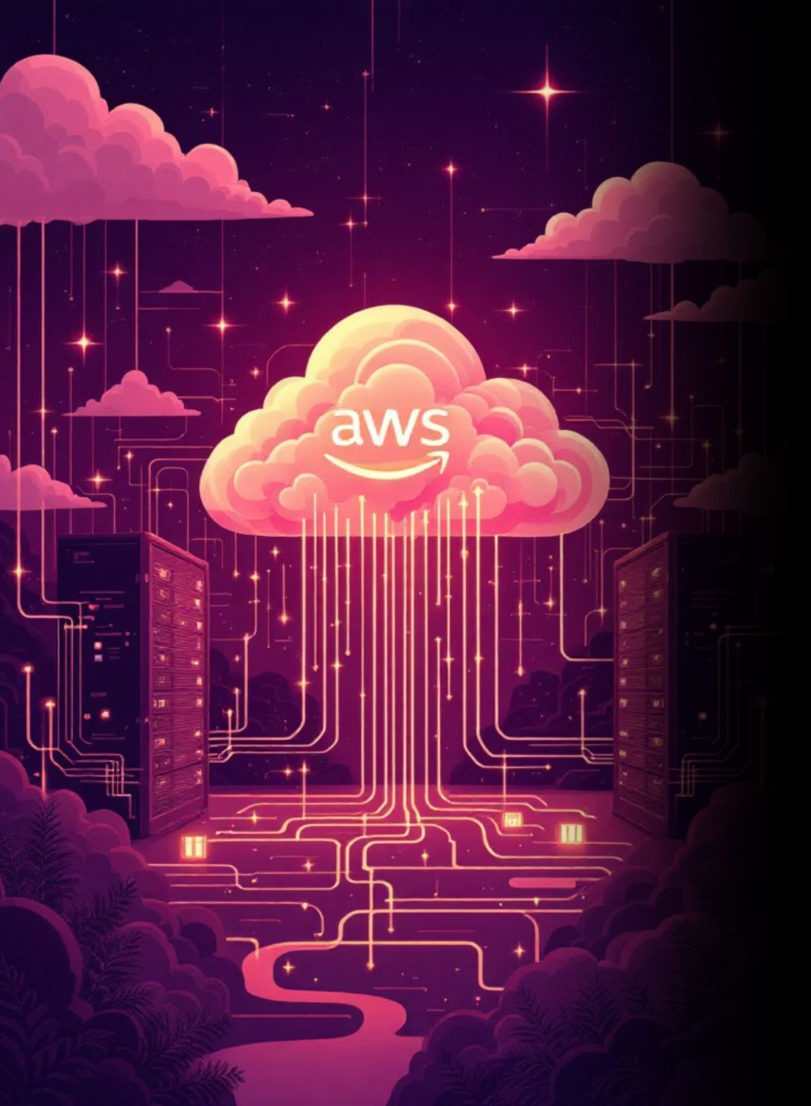
Production-Ready Scalable Web Architecture on AWS
Presented by: Ritik Mohadikar, AWS Cloud Engineer

Slide 2

Project Overview
Production Architecture
Security First
Auto Scaling
Designed and implemented a scalable web application architecture using multiple AWS services, built to production standards with high availability and fault tolerance
Implemented layered security with proper access controls, security group chaining, and network isolation to protect application components
Built dynamic infrastructure that automatically scales based on demand, ensuring optimal performance during traffic spikes while controlling costs

Slide 3
Why This Architecture Matters
Traditional Single Server Problems
Production Requirements
Single point of failure brings entire system down
Limited scalability during traffic surges
No automatic load distribution
Manual intervention required for scaling
Data persistence issues on instance failure
High availability across multiple data centers
Automatic scaling based on demand
Secure, encrypted communications
Persistent data storage across instances
Fault-tolerant, self-healing infrastructure

Slide 4
AWS Service Stack
Amazon EC2
Application Load Balancer
Elastic Compute Cloud for web server instances, running Apache web server hosting the application
Distributes incoming traffic across multiple EC2 instances, ensuring even load distribution
Amazon EFS
Auto Scaling Group
Elastic File System providing shared storage mounted across all EC2 instances for data persistence
Automatically adjusts number of EC2 instances based on traffic demand, from 0 to 5 instances
Virtual Private Cloud
Security Groups
Isolated network with public and private subnets, Internet Gateway, and NAT Gateway for secure connectivity
Layered firewall rules implementing least-privilege access between all components

Slide 5

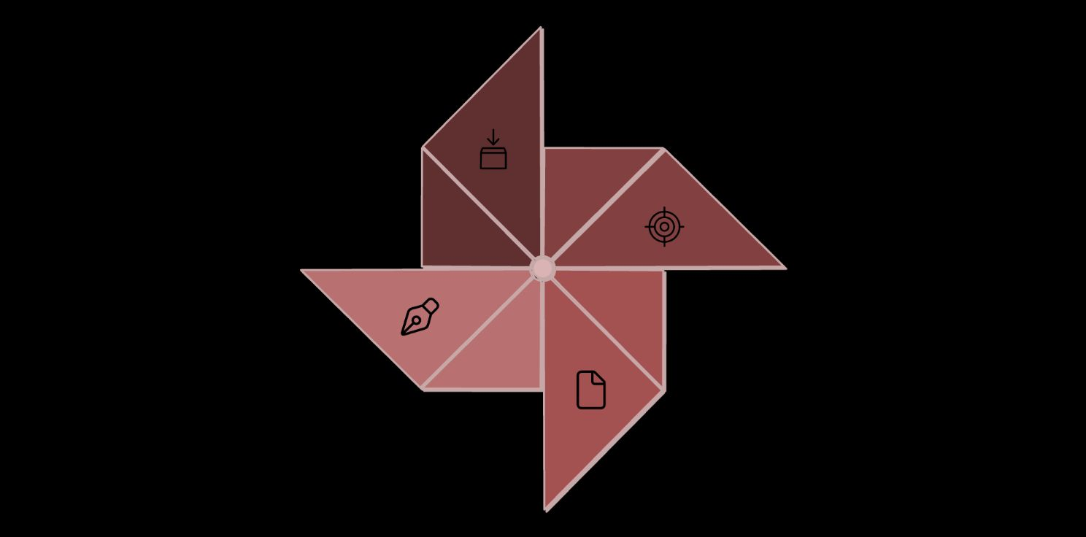
Architecture Data Flow
ALB → Target Groups
Client → ALB
Target → Auto Scaling
EC2s → Amazon EFS

Slide 6
Implementation Details
01
02
VPC Configuration
EC2 & Web Server
Created custom VPC with public subnets for ALB and private subnets for EC2 instances. Configured Internet Gateway for public access and NAT Gateway for outbound connectivity from private instances
Launched Amazon Linux 2 EC2 instance, installed Apache web server, configured security groups, and deployed web application code to serve user requests
03
04
EFS Integration
AMI & Templates
Created EFS file system with mount targets in each Availability Zone, mounted storage on EC2 instances at boot time to ensure data persistence across instance lifecycle
Created Amazon Machine Image from configured instance as golden template, built Launch Template specifying instance configuration for Auto Scaling Group deployment
05
06
Load Balancer
Auto Scaling
Configured Application Load Balancer with listeners on ports 80 (production web app) and 8080 (test environment), with health checks to automatically detect failed instances
Set up Auto Scaling Group with desired capacity of 2 instances, minimum 0 and maximum 5, automatic instance replacement when health checks fail

Slide 7

Security Implementation
Application Load Balancer
EC2 Instances
EFS Storage
Accessible only from ALB security group on port 80. No direct Internet access, only receives traffic from load balancer
Accessible only from EC2 security group on port 2049 (NFS). Protected mount targets prevent unauthorized access
Publicly accessible from Internet (0.0.0.0/0) on ports 80 and 8080. Accepts connections from any IP address
Security Group Chaining: Each component can only be accessed by the layer above it, implementing the principle of least privilege and defense in depth

Slide 8





Testing & Validation
Application Access
Verified web application loads correctly through ALB DNS address
Load Balancing
Tested traffic distribution across multiple instances using session persistence
Auto Scaling
Simulated traffic to verify instances launch and terminate automatically
Data Persistence
Validated files remain in EFS after instance termination and replacement
Fault Tolerance
Terminated EC2 instance manually, confirmed ALB routes to healthy instances

Slide 9
Challenges & Solutions
Challenge: Data Loss on Instance Failure
Solution: Implemented Amazon EFS for shared storage, ensuring data persists independently of EC2 instance lifecycle. Files remain accessible when new instances launch
Challenge: Traffic Overload on Single Server
Solution: Deployed Application Load Balancer with multiple target groups, distributing incoming requests evenly across all healthy EC2 instances in rotation
Challenge: Manual Scaling During Traffic Spikes
Solution: Configured Auto Scaling Group with dynamic policies, automatically launching or terminating instances based on demand without manual intervention
Challenge: Security Vulnerabilities
Solution: Implemented security group chaining with least-privilege access, isolated components in VPC subnets, and encrypted communications between all layers

Slide 10
Key Results & Future Roadmap
✓ Achieved Goals
→ Future Enhancements
High availability with Multi-AZ deployment
Automatic scaling from 0 to 5 instances
Secure architecture with layered security
Fault-tolerant system with self-healing
Data persistence through EFS
Efficient resource utilization
Implement HTTPS/SSL using AWS Certificate Manager
Configure custom domain with Route 53
Add CloudWatch monitoring and alerts
Build CI/CD pipeline with CodePipeline
Implement database tier with RDS
Add caching layer with ElastiCache
Conclusion: Successfully built a production-ready AWS architecture demonstrating scalability, high availability, and security best practices. This implementation provides a foundation for enterprise-grade web applications with automated scaling and fault tolerance.
Thank You

